Slide 1

A lesson of Physical Computing with Scratch: RPi, scratchClient and Arduino
Presentation for Pi And More 9½
Krefeld – 2017/01/14
Hans de Jong

Slide 2

Weekendschool
Generally parents tell their children: “Learn for later”. But what is later?
“I want to become an engineer. Do you maybe know an engineer? I would very much like to meet one”
EINDHOVEN 58 students
IMC Weekendschool
Trudo Weekendschool

Slide 3
Weekendschool
Goal and way of working
Bridge the gap between school and what is needed to live in society
Which is in more privileged families provided by the family
Don’t abandon them at the end: Alumni program
Data shows: alumni have better professional prospects, are more self-aware, and feel more connected with society.
Program includes training in presentation, research, debate, and conflict resolution – an allround character education.
Some numbers
> 1000 students in 2016 between 10 and 14 years of age
From disadvantaged neighbourhoods
3500+ volunteers
Funded by 110+ sponsors (companies, individuals, foundations)
Curriculum lasts for 2.5 to 3 years
Over 2100 alumni
Students are selected on motivation, not on IQ
IMC Weekendschool founded in 1998, Trudo Weekendschool in 2009
IMC Weekendschool has inspired 30+ other independent copy projects in The Netherlands (one of which is the Trudo Weekendschool).
Classes provided
Art
Medicine
Law
Philosophy
Astronomy
Politics
Mathematics
Physics
Programming
Film
Architecture
Entrepreneur
Language & Poetry
Safety
Energy
Journalism
… many more
More information
www.imcweekendschool.nl
www.trudoweekendschool.nl

Slide 4
Curriculum of Programming
Objectives
Learn how to use keyboard, mouse and screen without causing health problems.
Learn how to make programs in Scratch
Learn that programming is about more than changing pixels on a screen (Physical Programming).
Learn something about professional programming.
Build something tangible that can be taken home.
Let the children experience how powerful and joyful programming is.
3 lessons
Each lesson is 2x 75 minutes with 30 minutes break inbetween
Given to Weekendschool 2nd graders: 11 years old.

Slide 5
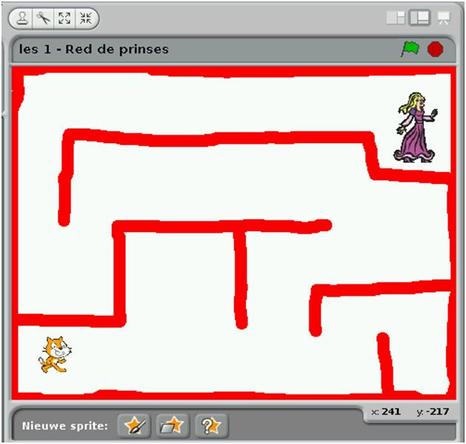
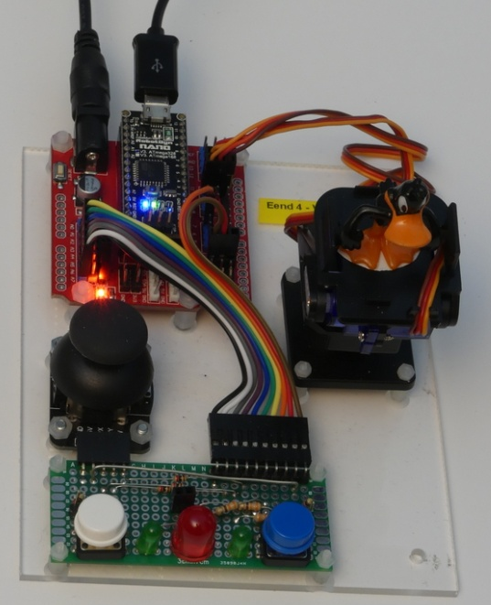
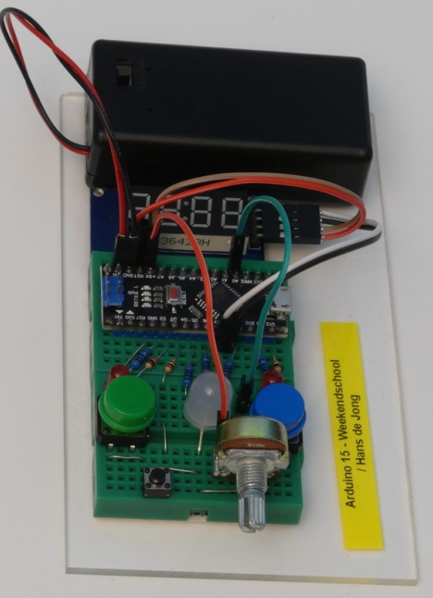
The 3 lessons of the curriculum
Lesson 1
Program a game in Scratch, output on monitor.
1 helper per 8 students.
Lesson 2
Physical computing controlled from Scratch.
1 helper per 4 students.
Could also be done in 2 lessons.
Lesson 3
Program an Arduino Nano from RPi.
Complete the electronic circuit of a game to be able to take home.
1 helper per 2 students.
Could also be done in 2 lessons.

Slide 6
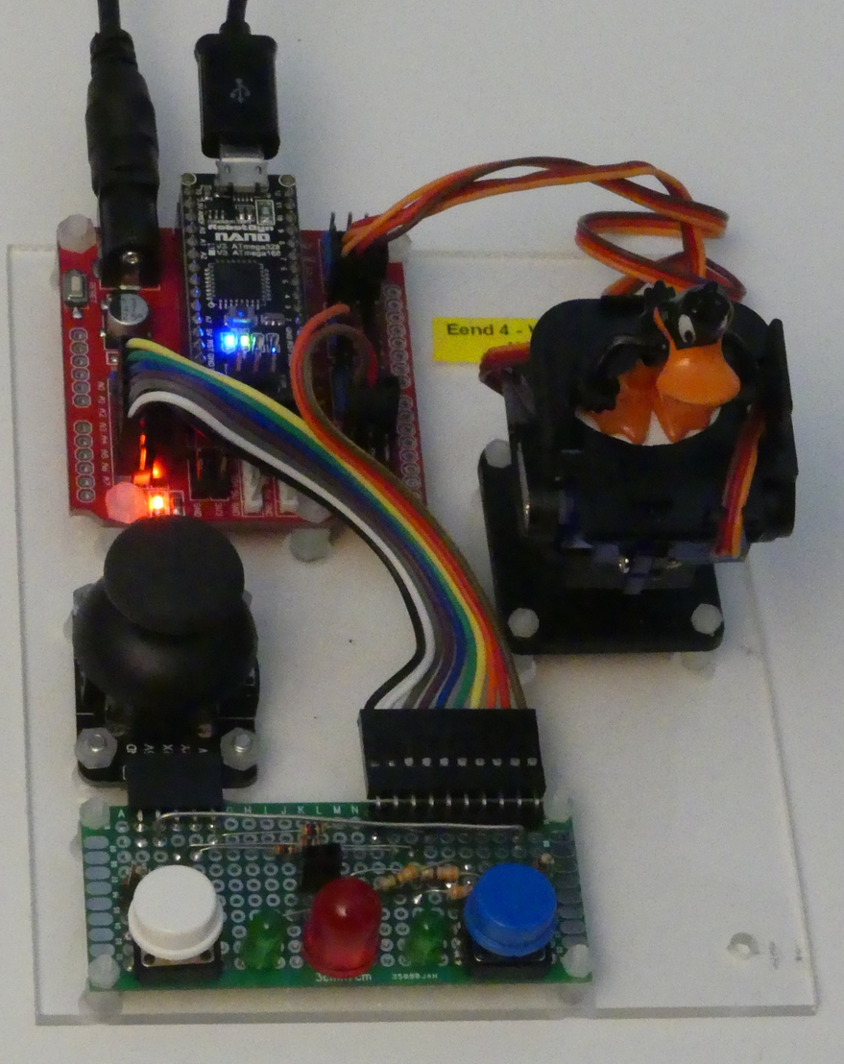
USB connection to Raspberry Pi (optionally via a powered USB Hub)
9 Volt power
(power of Raspberry Pi is too limited, and cheap microUSB cables cannot transport high current)
Duck on a pan/tilt platform to demonstrate the use of servos
Arduino Nano with 328p processor
Extension board
(handy connections with 3 pins per GPIO (VCC, GND and signal) to connect servos, power regulator)
Buttons and LEDs to demonstrate basic input / output
Joystick to demonstrate analog input

Slide 7
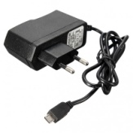
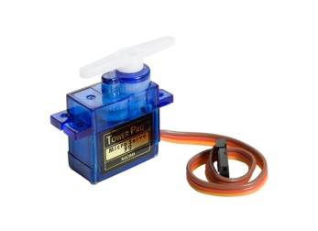
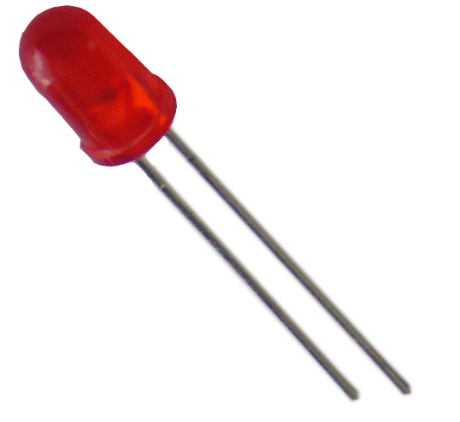
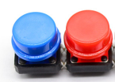


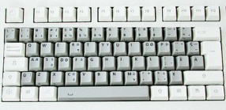
The setup
Raspberry Pi
2B or 3B
Powered USB hub
(not strictly needed since Arduino is powered separately – used for protection of RPi)
Arduino Nano
Scratch 1.4 run time
scratchClient
scratchClient Sketch
Remote Sensor Protocol Over socket 42001
Global variables
Broadcasts
Program in Scratch
Predefined sprites (with some code, sounds and costumes)
scratchClient Config file
Defines function of the GPIO pins on the Arduino (and RPi) and gives them logical names.
Standard setup
Programmed by the students
Prepared by the teacher

Slide 8
The game
Start the game by pressing the joy stick button (because it is there anyway)
Red LED lites at random
When LED lites, the first one pressing their button gets a point
The duck turns to the person scoring and makes a bow.
When the button is pressed without the LED being lit, the other gets a point
The duck turns to the one who pressed and shakes “no”.

Slide 9
Demo of the game
Have a look at
https://youtu.be/Qo1gnXNzhqE

Slide 10
Why using an Arduino* for GPIO rather than the GPIO of Raspberry Pi?
Arduino provides analog inputs.
Arduino provides hardware PWM (Pulse Width Modulation), which makes controlling servos more stable.
Arduino can support real time protocols (e.g. for controlling WS2812).
Arduino GPIO pins are 5V tolerant.
When making mistakes, blowing up an Arduino Nano is less costly (< 2.5 euro for a clone) than damaging a Raspberry Pi.
When needing more GPIO pins, extra Arduinos can be added.
scratchClient supports this as beta.
Easier setup and tear down in temporary classroom situations
Only needing to plug/unplug USB and power connectors.
Can be programmed to steer servos automatically to default position, ready for packing up.
* Arduino Nano or Arduino Uno can be used

Slide 11
scratchClient: things to know
Installing
Download scratchClient
http://heppg.de/ikg/wordpress/?page_id=6
Unpack
Install other packages as described in the documentation
Adapt the config file for Arduino Uno (which is used for Nano as well)
Use the Arduino IDE to program the scratchClient sketch in the Arduino
Note: when using Arduino clones, I have experienced problems with programming them from RPi with the Raspian release of 2016-05-10 and later.
Releases up to and including 2016-03-18 are OK
However, when NOT using the USB hub and when using Arduino IDE 1.8.0 and Raspian 2016-11-25 it works fine.
Start scratchClient with the correct config file as parameter.
Everything is described in the excellent documentation.
Good to know about the scratchClient config file
When disconnecting and re-connecting the Arduino, it may end up at a different /dev/ttyUSBx number.
However the config file refers to a fixed device name.
There is a program that will check at which port(s) – out of a range – there is an Arduino present and then dynamically adapt the ttyUSBx number.
This program is in beta.
For now – option 1:
Stop scratchClient
Disconnect the Arduino
Wait a few minutes
Reconnect
For now – option 2:
Duplicate the config file, adapt for diffent port numbers
Have a script that looks at the existence of the ttyUSBx number and then starts scratchClient with the correct config file.
The input / output naming of the Arduino GPIO pins is counter intuitive.
See the comment in the file. It is reverse from what is expected.

Slide 12
Cost and effort for the board
See Bill of Material on the next slide.
Material cost for a single piece: ca. 20 euro, but you will get spare material for that amount.
Material cost for a series for e.g. a school: can get sub 20 euro.
Labour content (no compensation included in the cost): ca. 2.5 hour.
Most components were ordered from Aliexpress.com.
Benefits
Extremely low prices.
Almost always shipped for free to The Netherlands, Germany and probably other EU countries.
Counterintuitive: the smaller the order, the more chance that there are no shipment costs.
Disadvantage
Never any data sheet and hardly ever precise specs.
So you will need to Google and find other sources. And sometimes just buy and try.
Delivery takes between 2 weeks and 2 months
Or arrives never (some 2% of shipments), but then refund is promptly done
Especially for power supplies: do not expect more than 50% of output current that is rated.
Otherwise it will overheat and blow up. Or the voltage drops way below what is needed.
Occasionally products are quickly running out
So make sure you order quickly the amount you need and some spare for the future.
Note: limit each order to max 22 euro (holds for all of the EU) if you want to avoid VAT, import duties and handling costs at the shipping company.
Secure payment possible (at least in The Netherlands: you can use IDEAL).

Slide 13
BoM (Bill of Material)
The URLs are in the Excel file on github. See slide 16.

Slide 14
What can scratchClient do further?
As well control all the GPIO pins on Raspberry Pi.
Run on a Windows PC and in combination with Arduino provide physical computing to Scratch running on Windows.
Monitor the hardware state from a browser.
Watch all the variables in the RPis from a central Windows PC.
Allow to use Arduino Uno instead of Arduino Nano.
Allows to use predefined configurations for experiments.
Minimizing the trouble with I/O configuration.
Keep apart multiple connected Arduinos and address the right GPIO pins on the correct Nano (in beta now).
So the number of connectable peripherals is virtually infinite.
My conclusion:
scratchClient is the ideal software to bring physical computing to Scratch!

Slide 15
Try for yourself?
Attend my workshop at 13.00 today
You can there try it out for yourself (2 people per workplace setup)
Registration mandatory (with the Pi And More organisers)
Hurry up, because the amount of places is limited
Workshop will be in English (presentation, material, support)
There will be German spoken support in addition to English
Gerhard Hepp, author of scratchClient, will be present.
You will learn how to configure scratchClient, control hardware from Scratch, build up a test board and – if you want – take a look at the game.

Slide 16
More information
This presentation, source files of the game and workshop material
www.github.com and search for Weekendschool or for PiAndMore
scratchClient
http://heppg.de/ikg/wordpress/?page_id=6
Scratch
https://scratch.mit.edu/
Scratch on Raspberry Pi
https://www.raspberrypi.org/forums/viewforum.php?f=77
Raspberry Pi
https://www.raspberrypi.org/
Arduino
https://www.arduino.cc/

Slide 17
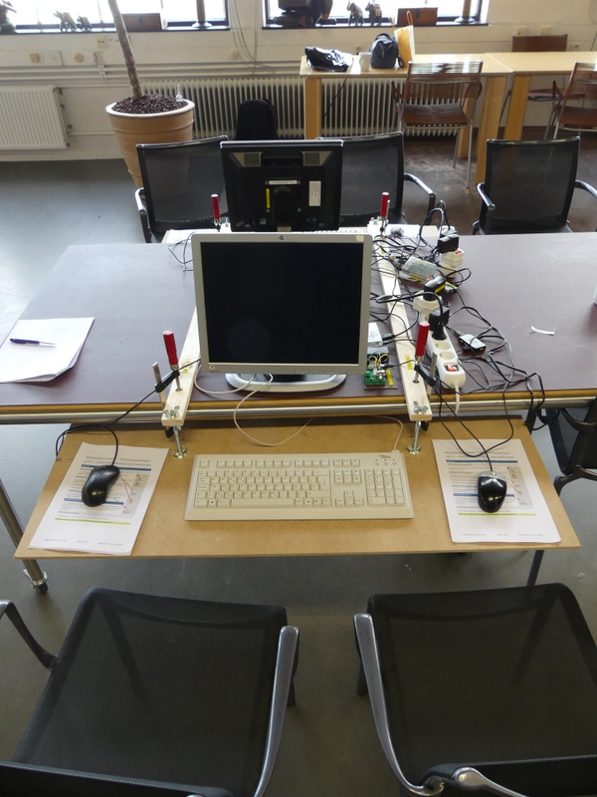
Making a workplace for 2 students
Raspberry Pi 3B
With power supply
With 16 GB microSD card
Second hand monitor HP1750 or HP1740
Second hand keyboard
Second hand mice (2x)
so they can each use a mouse and can be instructed: learn to use your left hand for the mouse as well.
MDF 9mm board (better: 2x 4mm with 12 mm filler in between)
See further the pictures
For 2 workplaces opposite of each other: 2 laths, 4 clamps, 4 threaded rods M8, 4 nuts, 8 large washers, 12 butterfly nuts.
84 liter crates of RUB (Really Useful Boxes, http://www.reallyusefulproducts.co.uk/) can very precisely contain 4 monitors (2 dismounted from their pedestal) and cables.
Ergonomics: keyboard at the correct height to teach children to pay attention to how they sit when using computers to avoid medical problems (RSI) later in life.

Slide 18
Questions?

